Slide 1
Kaput
By Team Modemas

Slide 2
Introduction
App name – Kaput
Team – Modemas
Goal – creating a Kahoot like game that can automatically generate questions by using AI.

Slide 3
Solution
This is where Kaput comes in.
Kaput uses AI-generated questions to dramatically reduce preparation time.
What once took hours can now be done in minutes.

Slide 4
Architecture
Frontend
Backend
Frontend and Backend communicate via SignalR
Questions are generated by API call to a seperate service (a docker container that hosts ollama models).

Slide 5
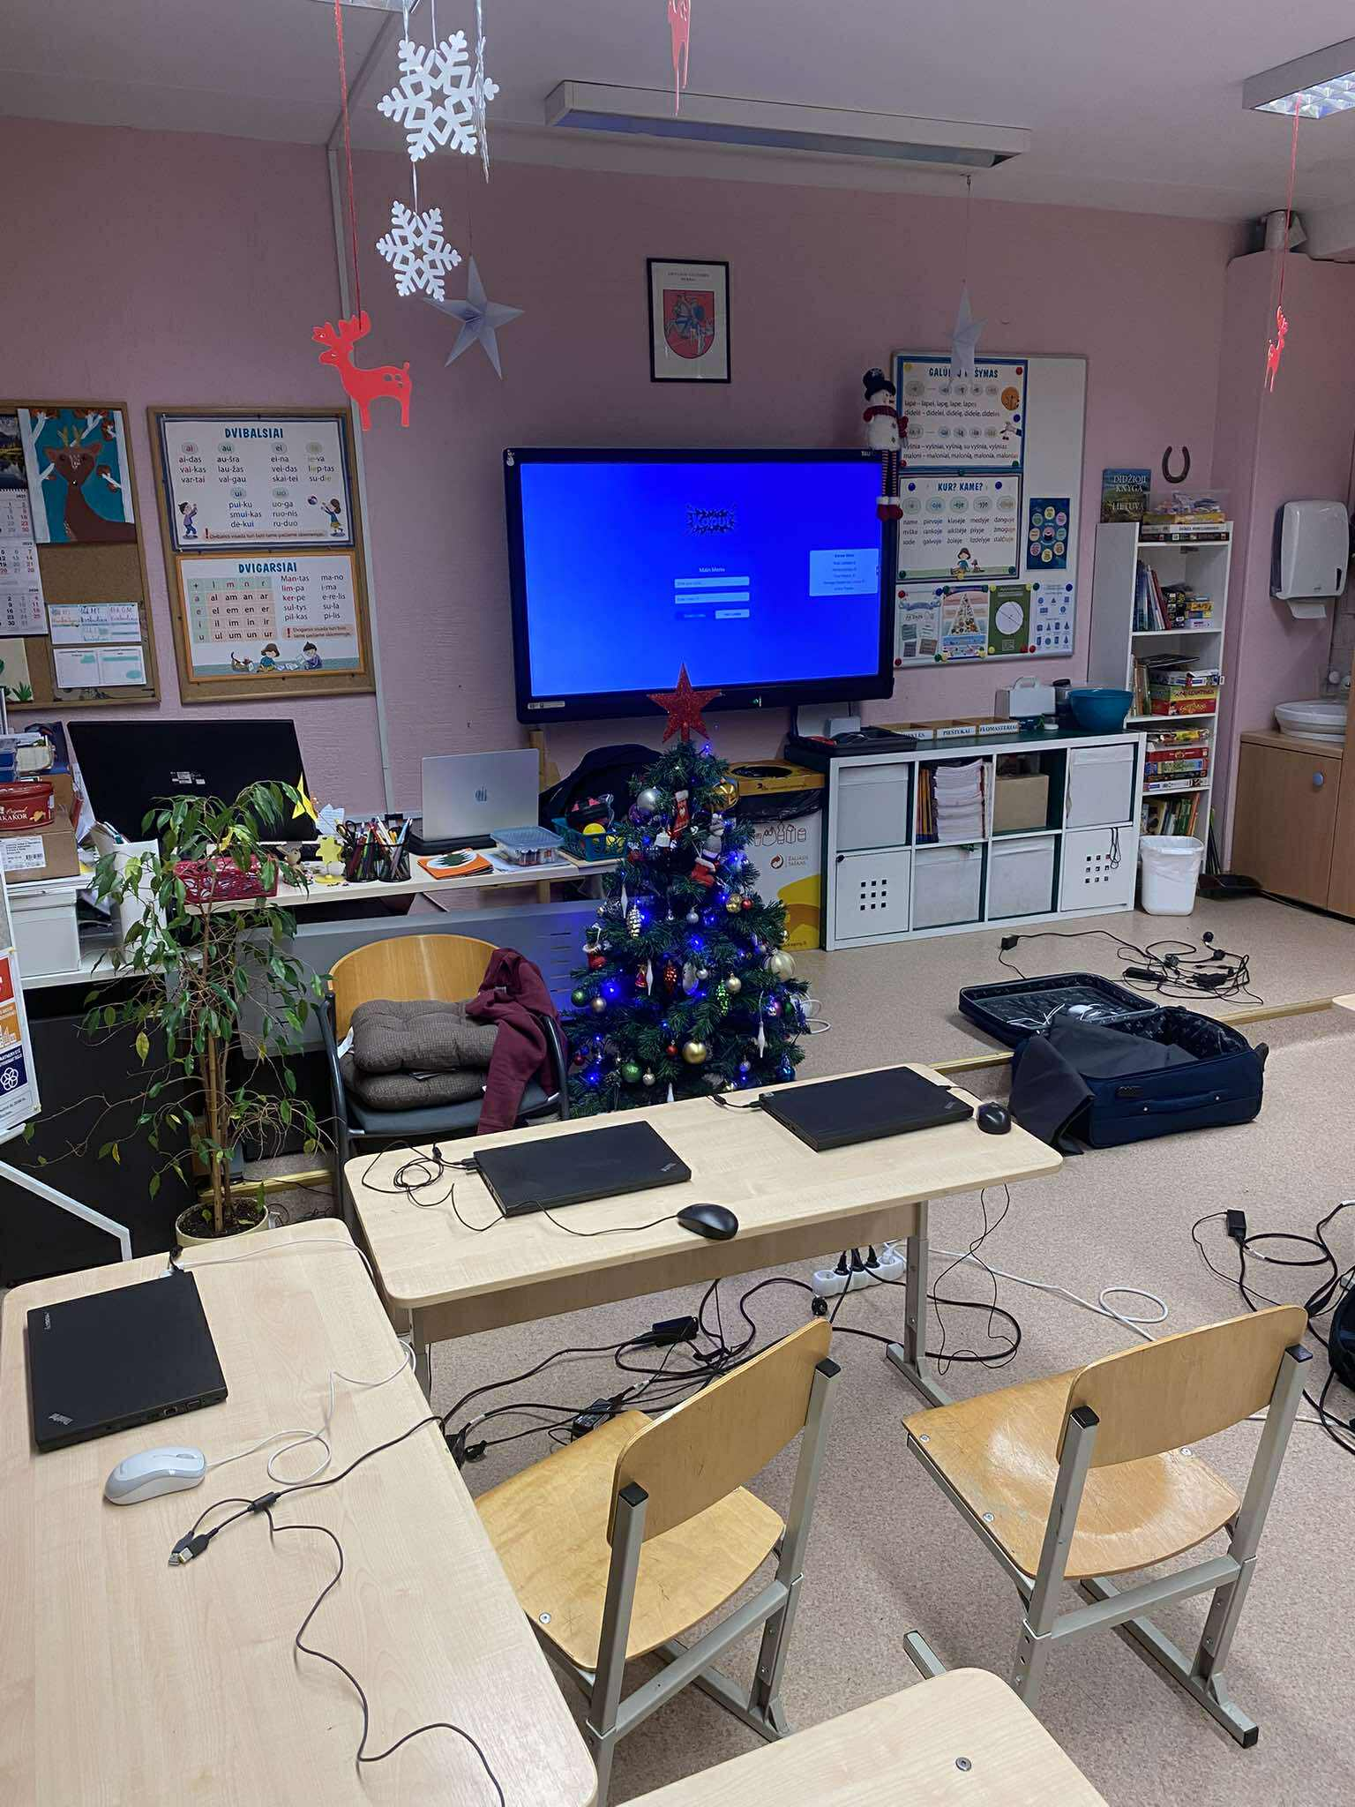
Live testing

Slide 6
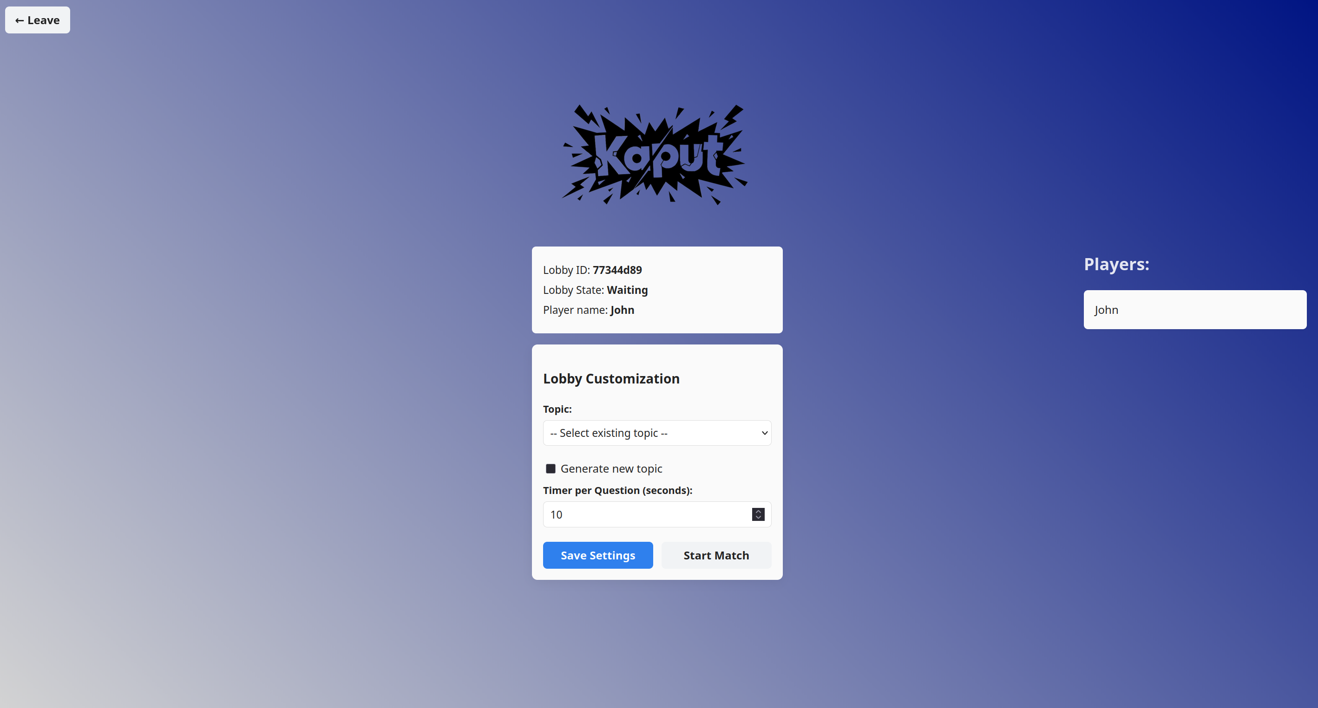


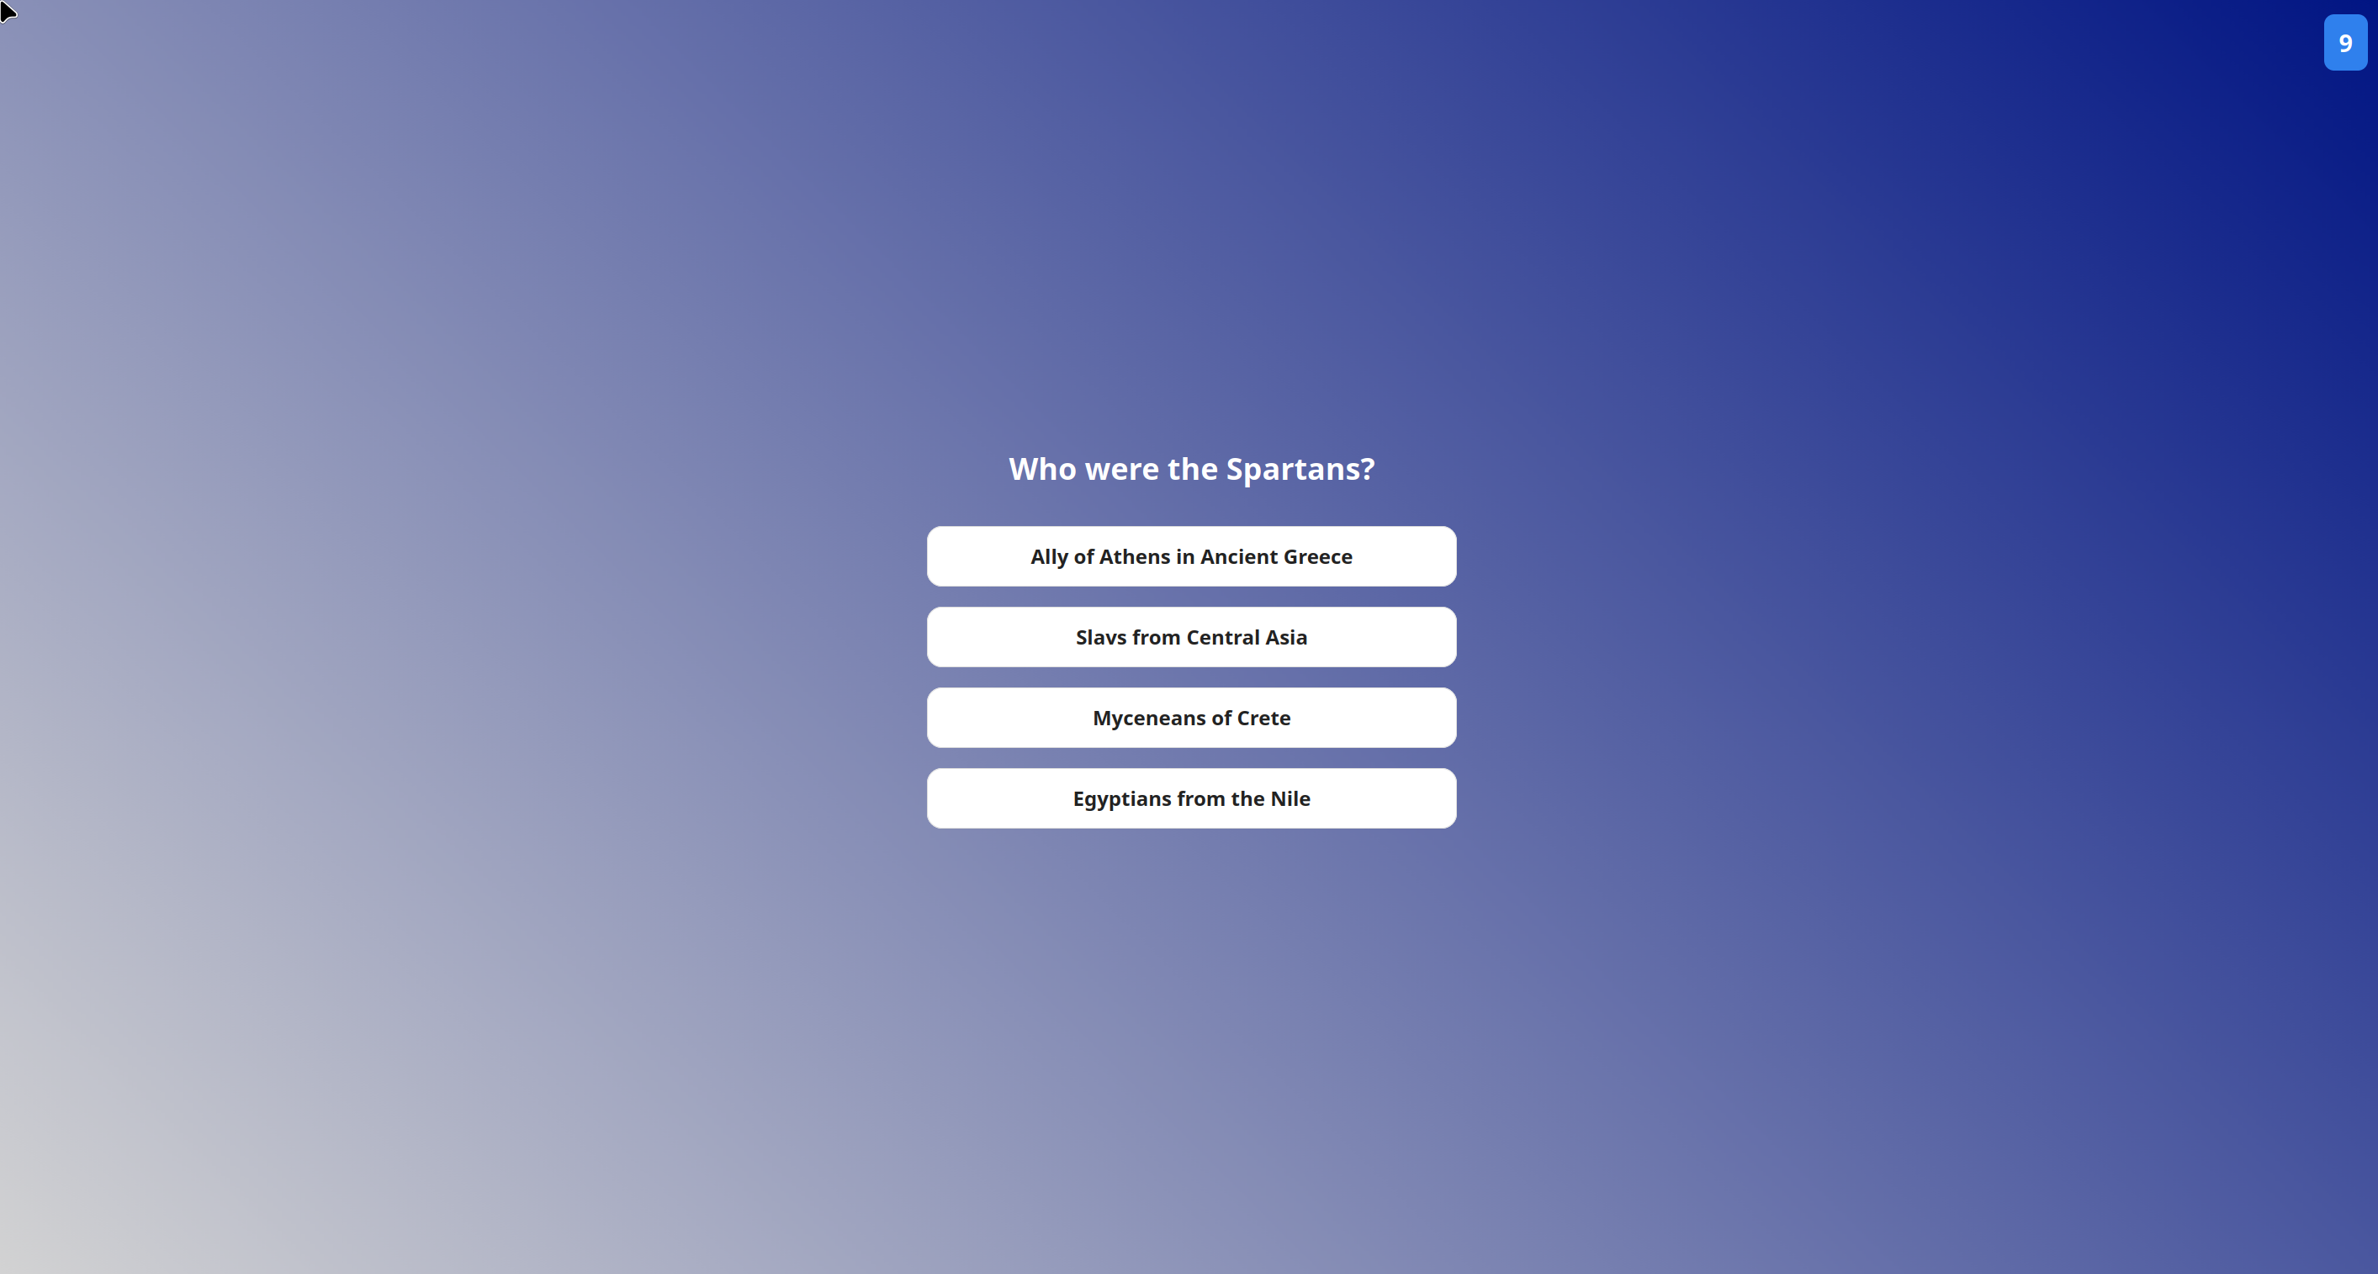
Demo
Proof that our application works.

Slide 7
Problem
Teachers use interactive quizzes as part of their lesson.
Manually creating these quizzes is time-consuming.
Teachers can either spend long hours working, or abandon quizzes altogether.

Slide 8

Testing & Reliability

Slide 9
Value proposition
For teachers who struggle with limited time and heavy workloads,
Kaput is an AI-powered live quiz platform that automatically generates interactive quizzes in minutes.
Unlike traditional quiz tools that require manual question creation, Kaput reduces preparation time from hours to minutes by using AI-generated content.

Slide 10
Value proposition
For teachers who struggle with limited time and heavy workloads,
Kaput is an AI-powered live quiz platform that automatically generates interactive quizzes in minutes.
Unlike traditional quiz tools that require manual question creation, Kaput reduces preparation time from hours to minutes by using AI-generated content.

Slide 11
Thank you for your attention!

